Slide 1
Project Analysis Jorgen Konini

Slide 2
Project analysis slide 2
Project Analysis
PURPOSE
PROJECT
TECHNOLOGIES
WHAT I HAVE LEARNED

Slide 3
Project analysis slide 6
Project Purposes
Submitting, storing, searching, and retrieving test data in dynamic way.
Making the test taking process automated and simplified.
Having the necessary data centrally located so it would be easy to share with specific users of the system.
Storing and retrieving specific user data to keep reports on each taken test.
Making the test taking process more secured and easier to validate the answers.
Making the data centralized so it would be easy to secure, update and backup.

Slide 4
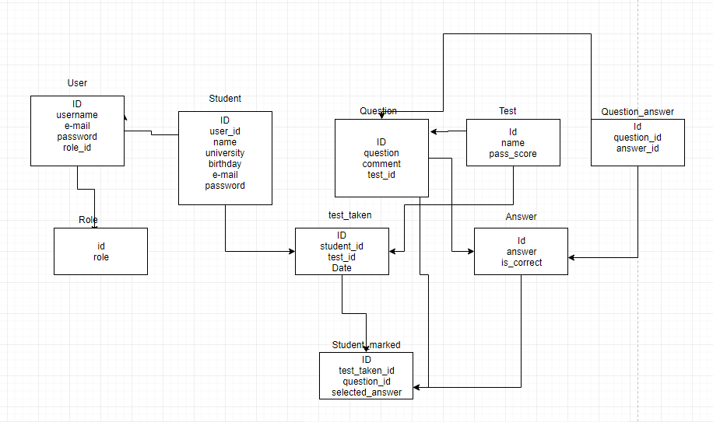
Data Base ER-Schema

Slide 5
Project analysis slide 8
Technologies
Front End
Back End
Java Server Faces (JSF)
JavaBeans
JSF is a framework that encourages building user interfaces for JavaServer applications.
JSF is used in the project to connect UI widgets with data sources and/to server-side event handlers.
JavaBeans are used to encapsulate many objects into a single object, so that they can be passed around as a single bean object instead of as multiple individual objects.
HTML, CSS, JavaScript
Hibernate
HTML is used to provide the basic structure of the sites, mainly used in index.html.
CSS is used to control presentation, formatting, and layout.
JavaScript is used to control the behavior of different elements inside each file.
Hibernate is used as an object-relational mapping tool for the Java programming language.
It is used to provide a framework for mapping an object-oriented domain model to a relational database.

Slide 6
Project analysis slide 4
Technologies
Tasks
JSF
Hibernate
Database
Front End
Back End
HTML, CSS, JavaScript
JavaBeans

Slide 7
Project analysis slide 3
What have I learned
DATABASE MANAGEMENT ABILITIES
DESIGNING ABILITIES
DEVELOPMENT ABILITIES
PROJECT MANAGEMENT ABILITIES
TECHNOLOGY INTEGRATION
Regardless of programming language of choice , front-end programming allowed me to see how the app will interact with the design.
To accommodate the changing needed and numbers of the users the web application, I became familiar with Model View Controller architecture.
Project management skills helped me get all tasks done quicker and more successfully.
Solid understanding of technology stacks (and how they integrate with each other) so that I would create useful, sustainable application.
To have a collection of centralized data, I learned how to base the web-application into web-database-application.

Slide 8
Thank You

